Slide 1

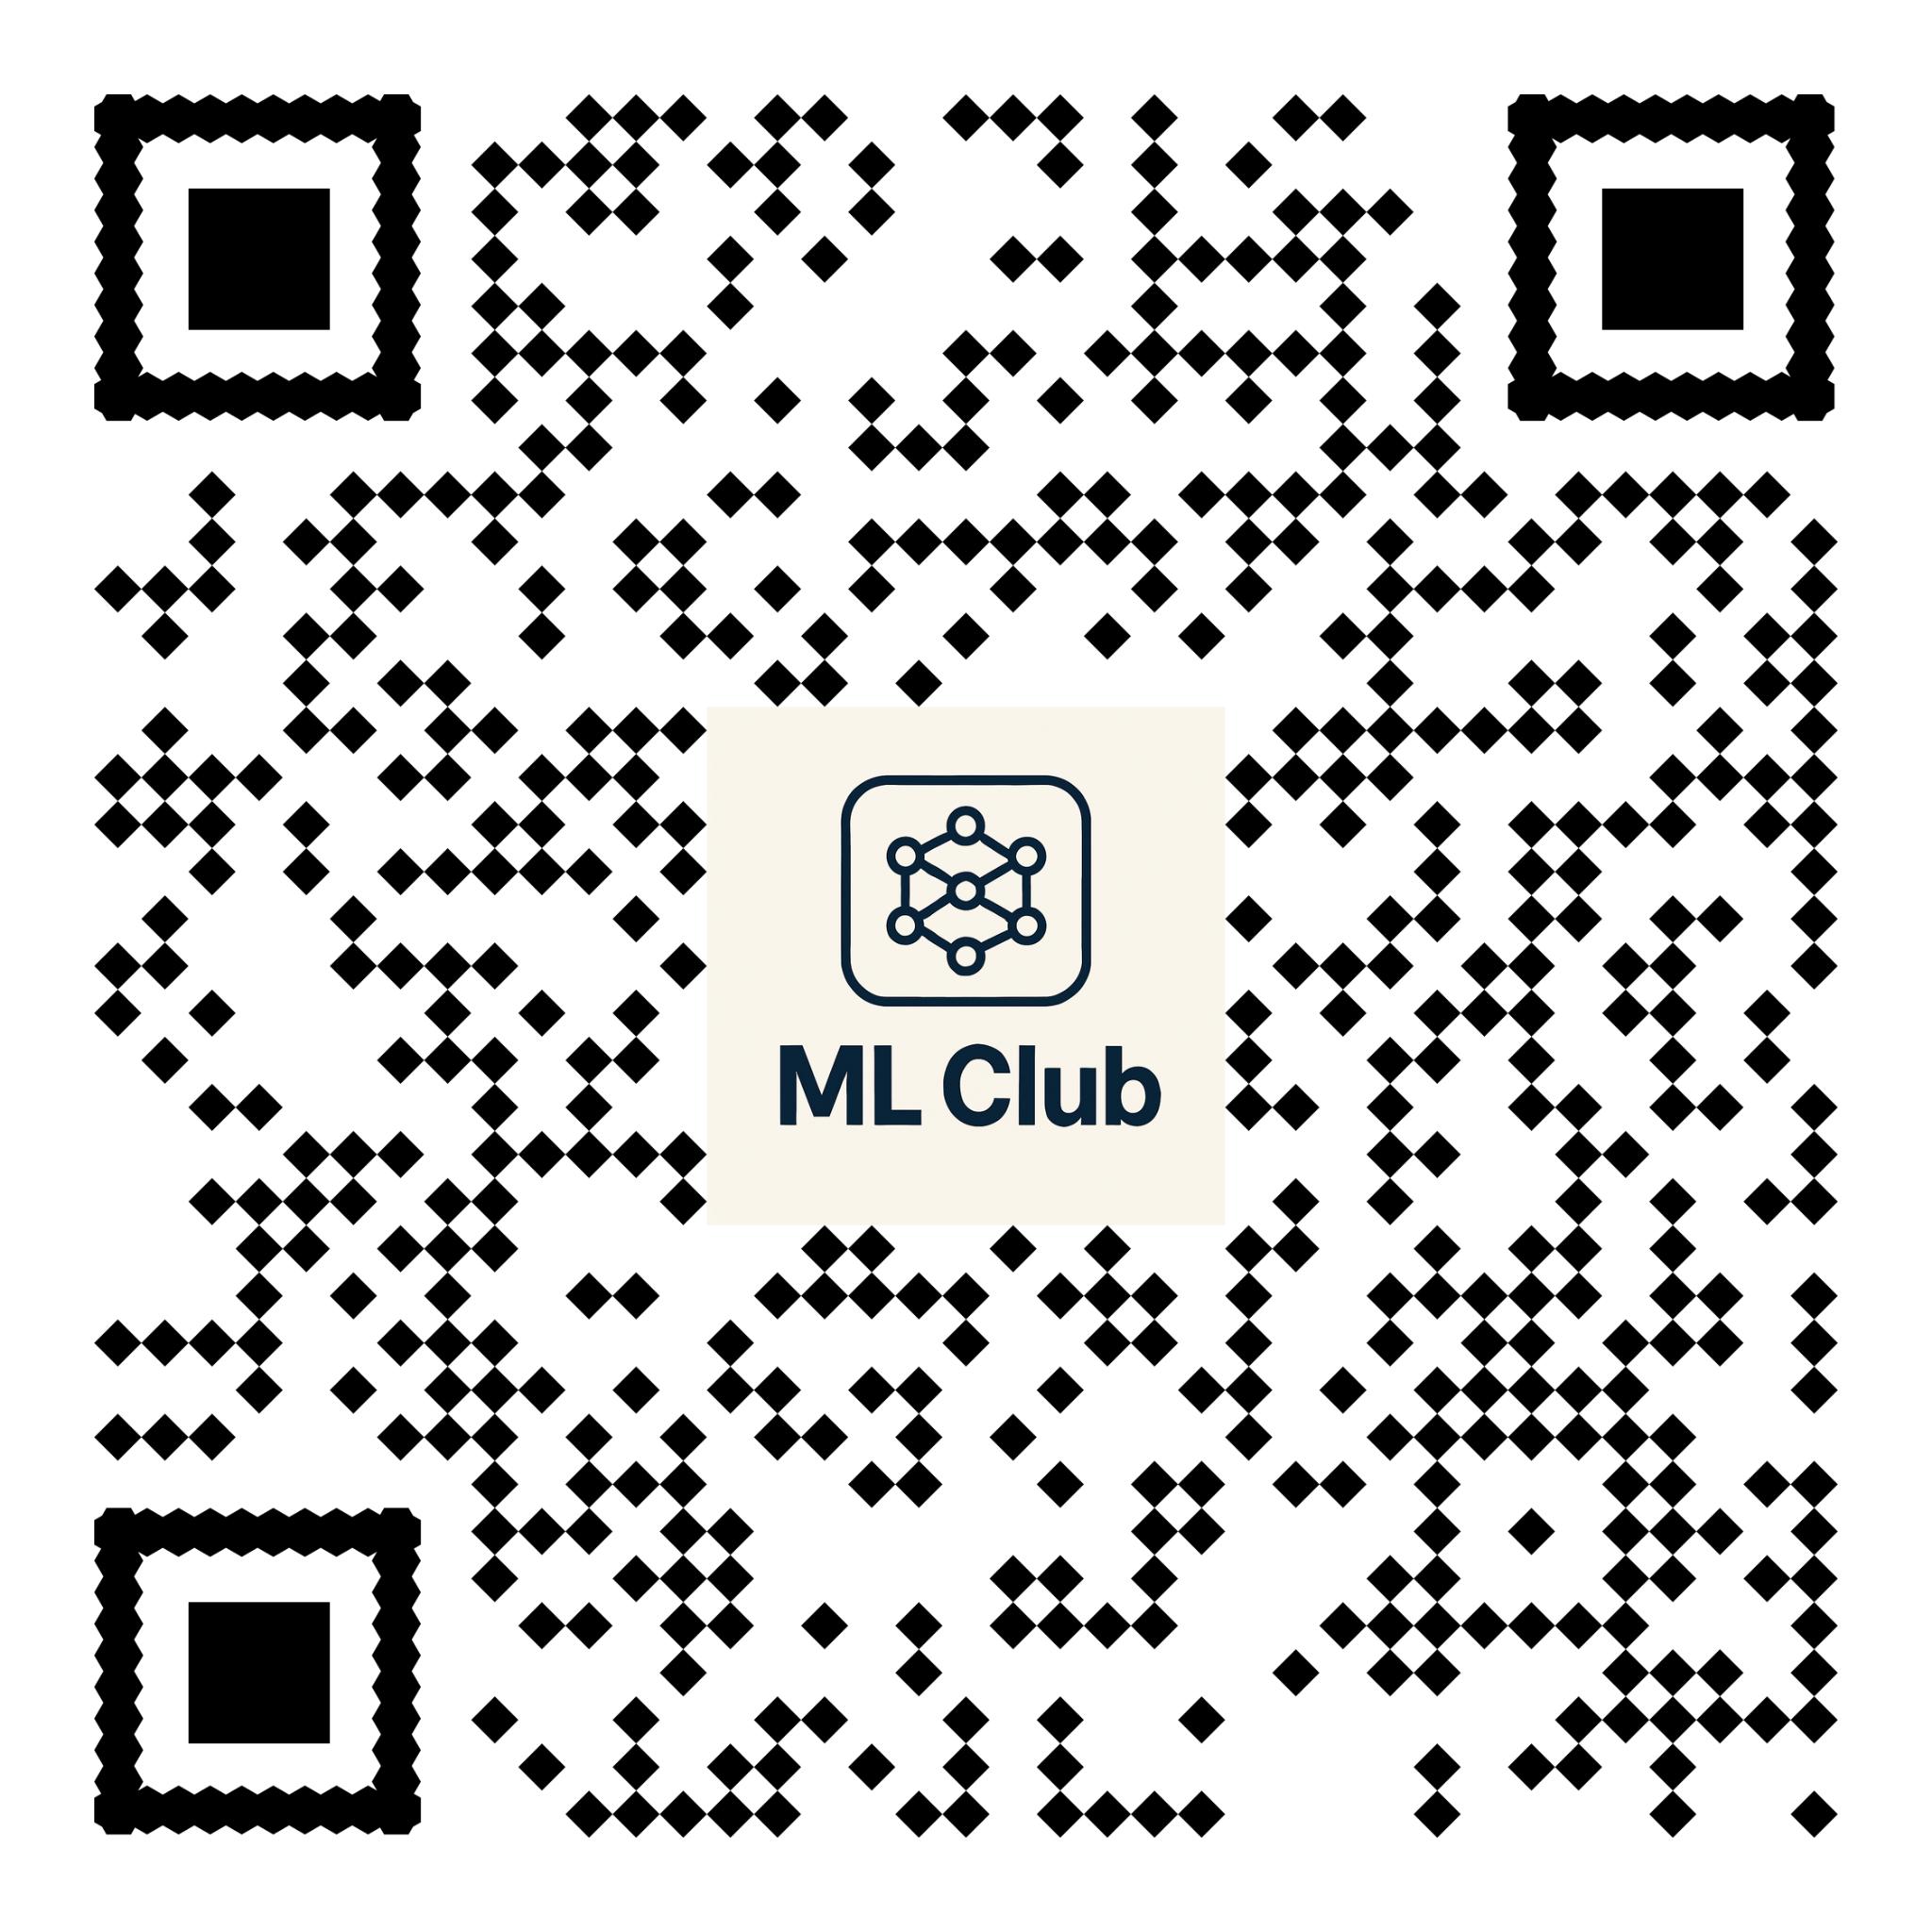
ML Club - October 2025 Meetup
Kindly supported by : Streamba Unified Oil & Gas Supply Chain Command: Integrated Platform, Proven AI & Strategic Ecosystem
Streamba
Follow ML Club on LinkedIn

Slide 2
Agentic AI: The Next Frontier in LLM-Powered Workflows

Slide 3


A bit about me
Manuele Tacchetti
Recent First-Class Honours Computing Graduate
Specializing in Agentic AI & Cloud Deployment
Connect on LinkedIn

Slide 4
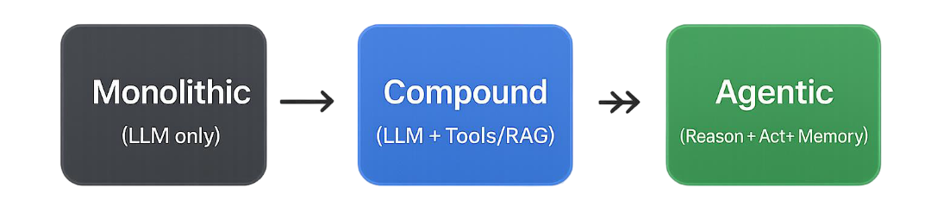
From Generative to Agentic AI
Traditional LLMs are reactive and limited by training data.
Compound AI Systems (e.g., RAG) integrates models and tools into a fixed process, where those tools are used for the LLM (not autonomously by it).
Example: A RAG chatbot hard-coded to search its database first, then give the results to the LLM to answer.
Agentic AI goes further: reasoning, planning, memory, and autonomous action.

Slide 5
How AI Agents Work
Agentic Cycle: Perceive → Decide → Act → Learn.
LLMs provide reasoning (Chain-of-Thought).
Tools = external programs (APIs, DBs, code).
Memory enables context + personalization (e.g., Conversation History or Vector DB).

Slide 6
Types of Agents
Agent Type | Example Agent | Agent's Goal & Action
Goal-Based Agent (Focus: Planning/ReAct) | Web Research Agent | Goal: Find the current market price for an Nvidia H100 GPU. Action: Uses a single sequence (ReAct -Reason + Act) to state the price.
Utility-Based Agent (Focus: Self-Correction/Reflexion) | Code Debugging Agent | Goal: Fix a Python bug. Action: Writes a fix, executes the test, perceives the failure, and rewrites the code (self-correction/Reflexion) until the tests are passed.
Learning Agents (Focus: Improvement) | AI-Powered Customer Service Bot (with human feedback) | Goal: Continuously improve customer issue resolution. Action: Resolves queries, receives human feedback on resolution quality, and uses it (e.g., through automated fine-tuning) to iteratively refine its effectiveness.

Slide 7
Multi-Agent Systems (MAS)
Challenge: Single agents face context overload, error tracing issues.
Solution: MAS distribute roles among specialized agents.
A Multi-Agent System (MAS) integrates multiple individual agents, which typically vary in type, role, and sophistication. This collaboration allows for specialized and robust problem-solving.

Slide 8

Main Patterns Definition
Pattern | Definition | Example
Sequential Pipeline | Agents work one after another, passing the result from the previous agent to the next one in a linear flow. | Research => Analysis => Writing => Review
Parallel Aggregation | Multiple agents run concurrently, and their independent results are then collected and aggregated. | SEO analysis, fact-checking. All agents run simultaneously and their outputs are merged.
Interactive Dialogue | Agents exchange messages back and forth with each other to clarify, negotiate, or refine the task, solution, or requirements. | A Requirements Agent queries a Data Agent to clarify needed data before finalizing the project scope.

Slide 9
Showcase: Multi-Agent Marketing Assistant
Built with LangGraph, designed as daily content assistant.
System Type: A Multi-Agent System (MAS) operating as a Sequential Pipeline of specialized, Goal-Based Agents.
Scout Agent: retrieves real-time data.
Strategist Agent: aligns data with Marketing Playbook (RAG).
Creator Agent: produces Daily Marketing Brief.

Slide 10
Conclusions
Future AI = hybrid systems (generative + agentic) will add autonomous reasoning, planning, and self-correction.
System choice must balance complexity with risk tolerance.
MAS (like Agentic RAG) enhance reliability via specialization.
LangGraph enables durable, stateful orchestration.
Agentic AI is the next frontier of intelligent automation.

